Slide 1


Meeting
Dashboard Technology

Slide 2
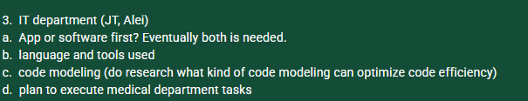
Content

Slide 3

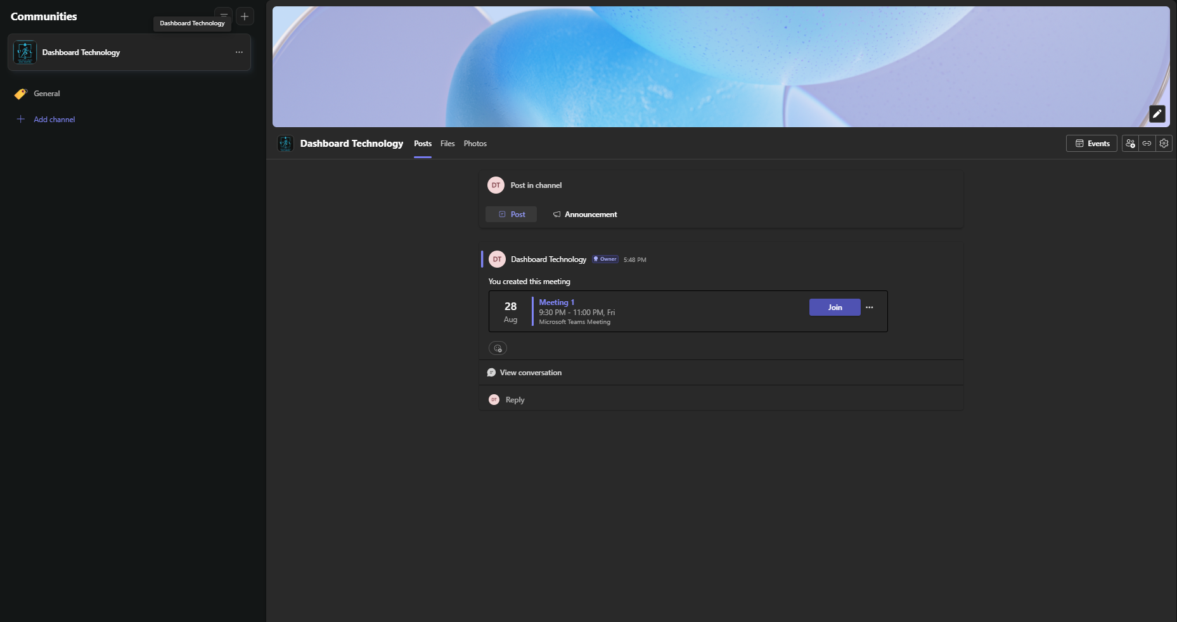


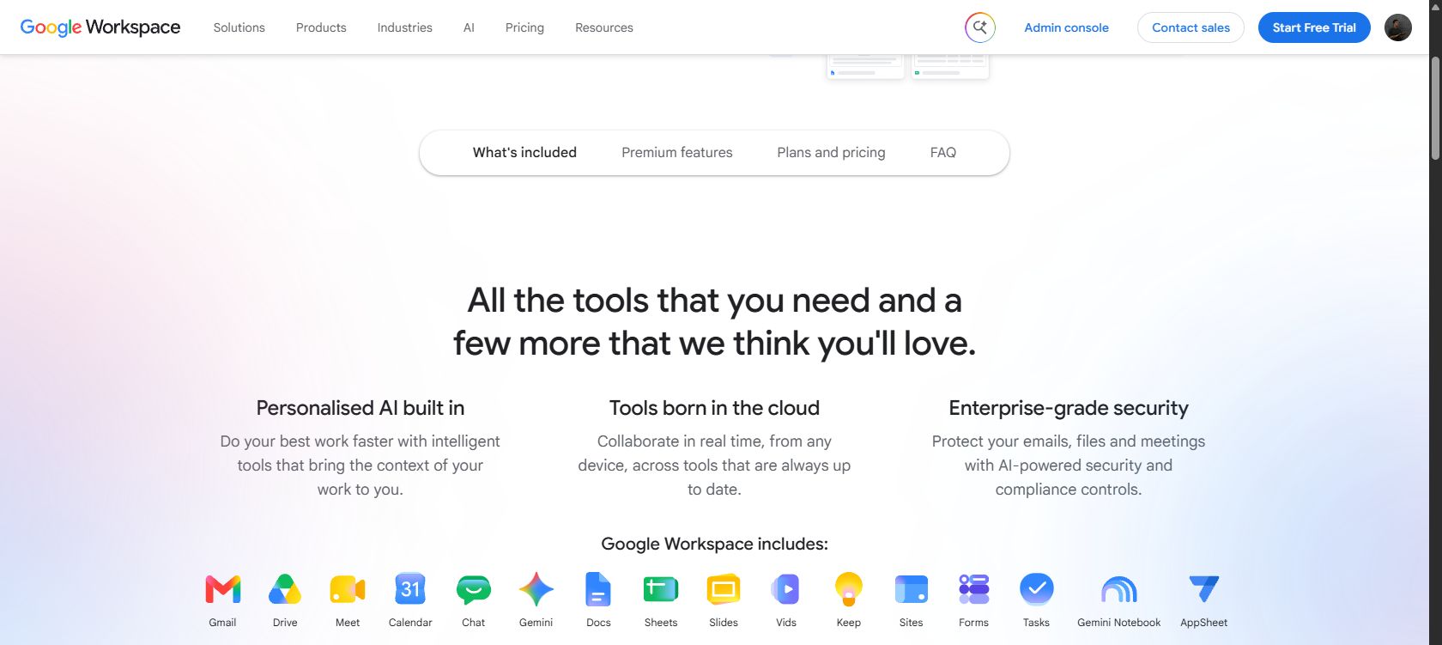
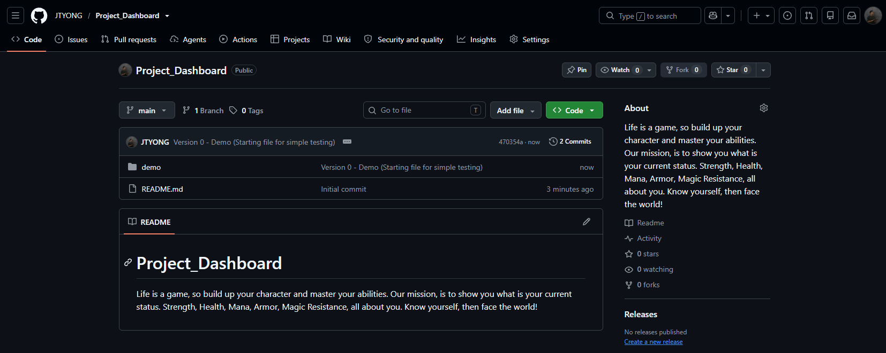
Working Platform
Collaboration and Communication
*Surveyed by Aleister, Thanks.
Code and Structural Files

Slide 4

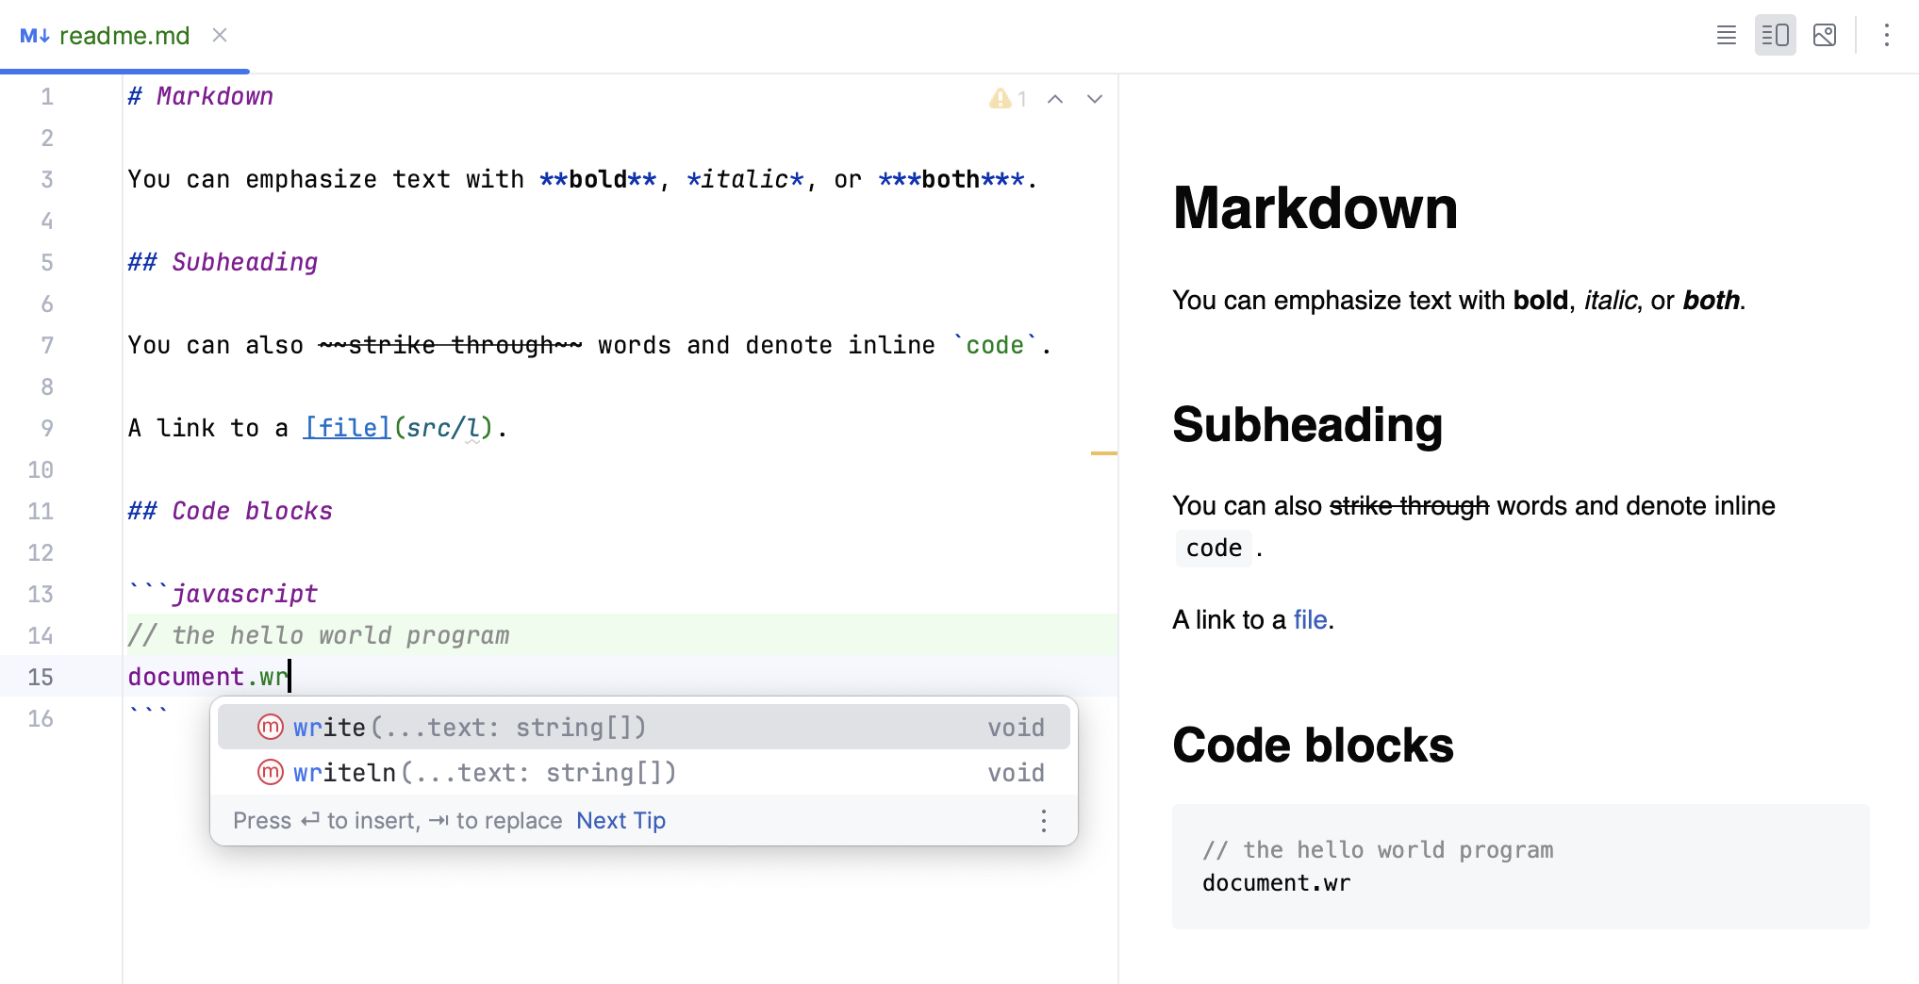





Project Structural
Scheme | Language/Tools | Remarks
Frontend
Backend
Database
Especially if connect LLM
Still checking if need to combine
Still haven’t check, sorry. Will update as soon as possible

Slide 5
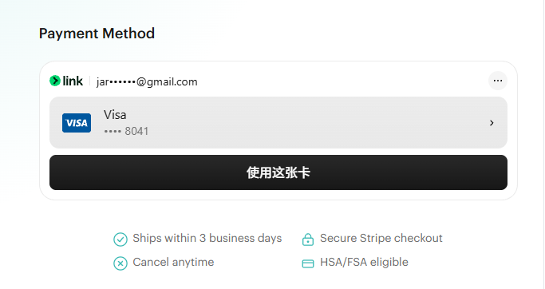

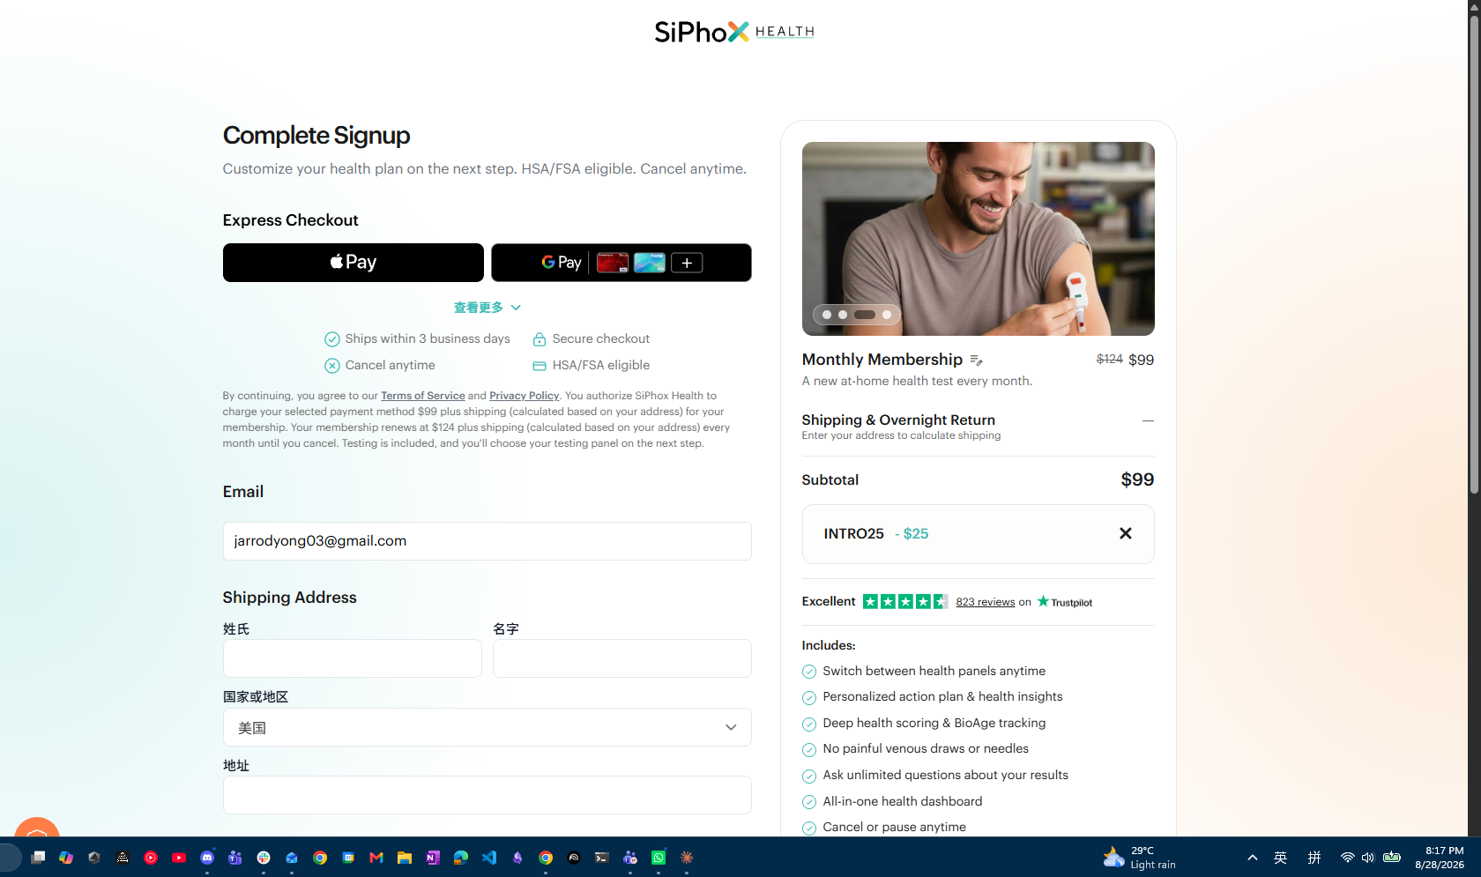
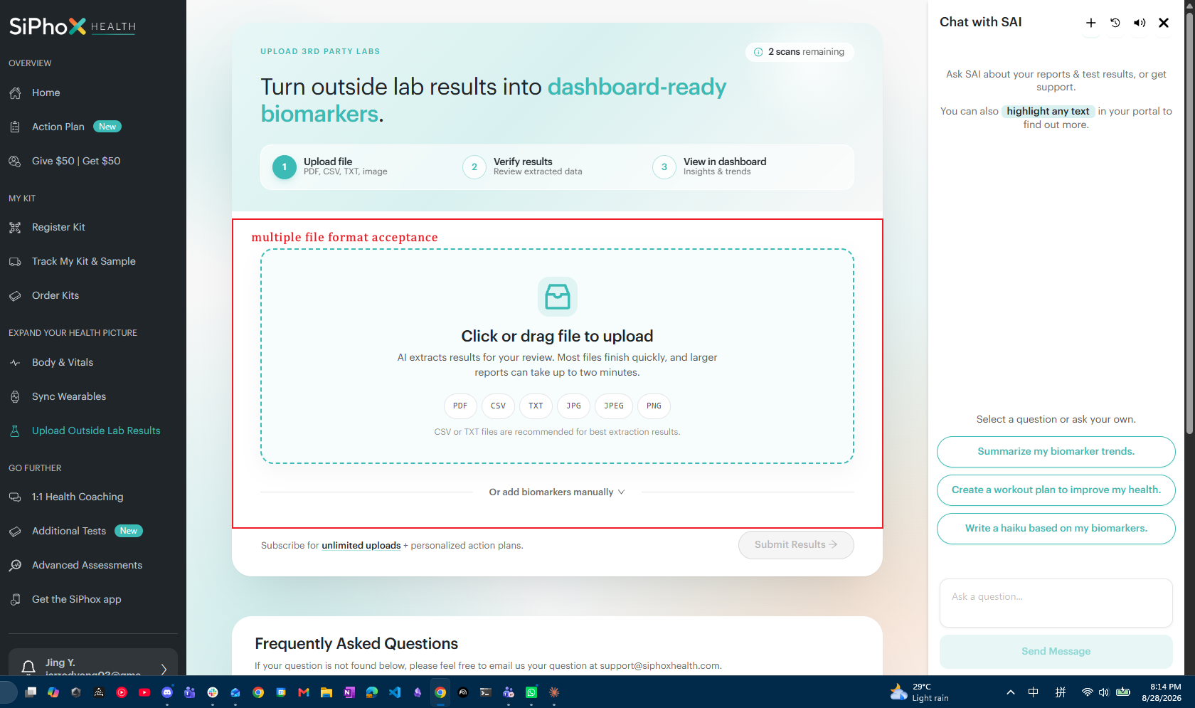
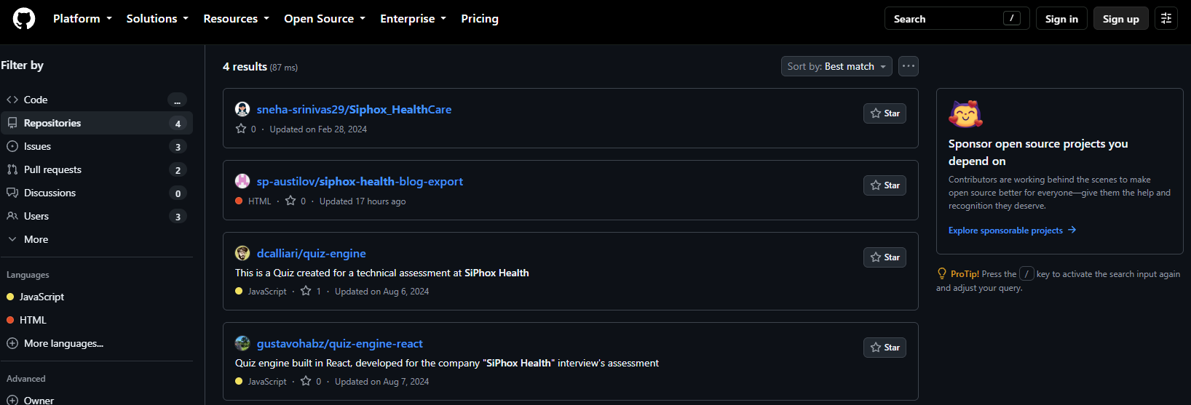
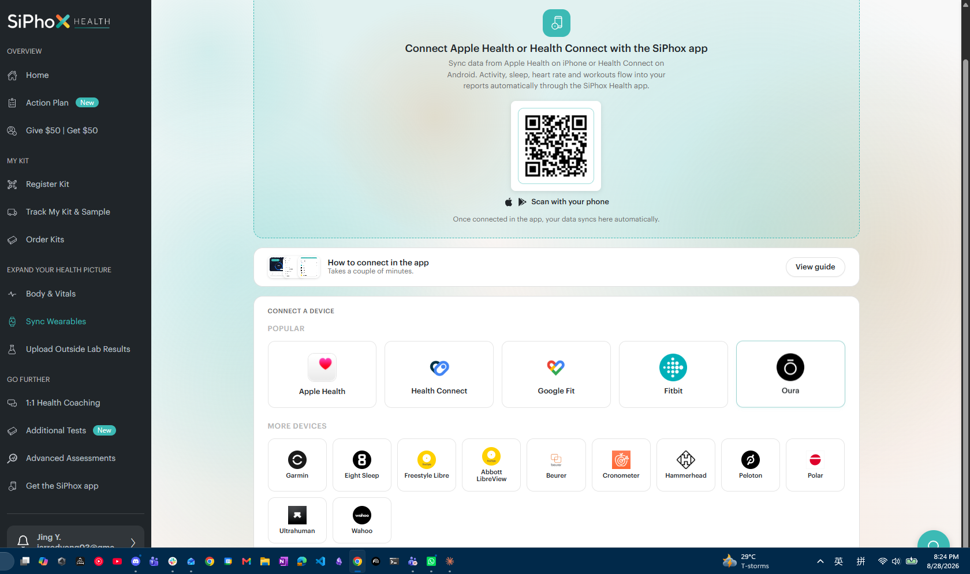
Web review – Has other ppl done similar things
Ai Chatbox
Membership

Slide 6

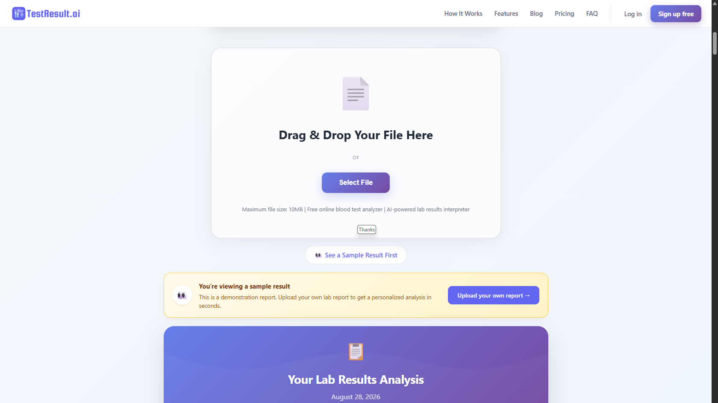
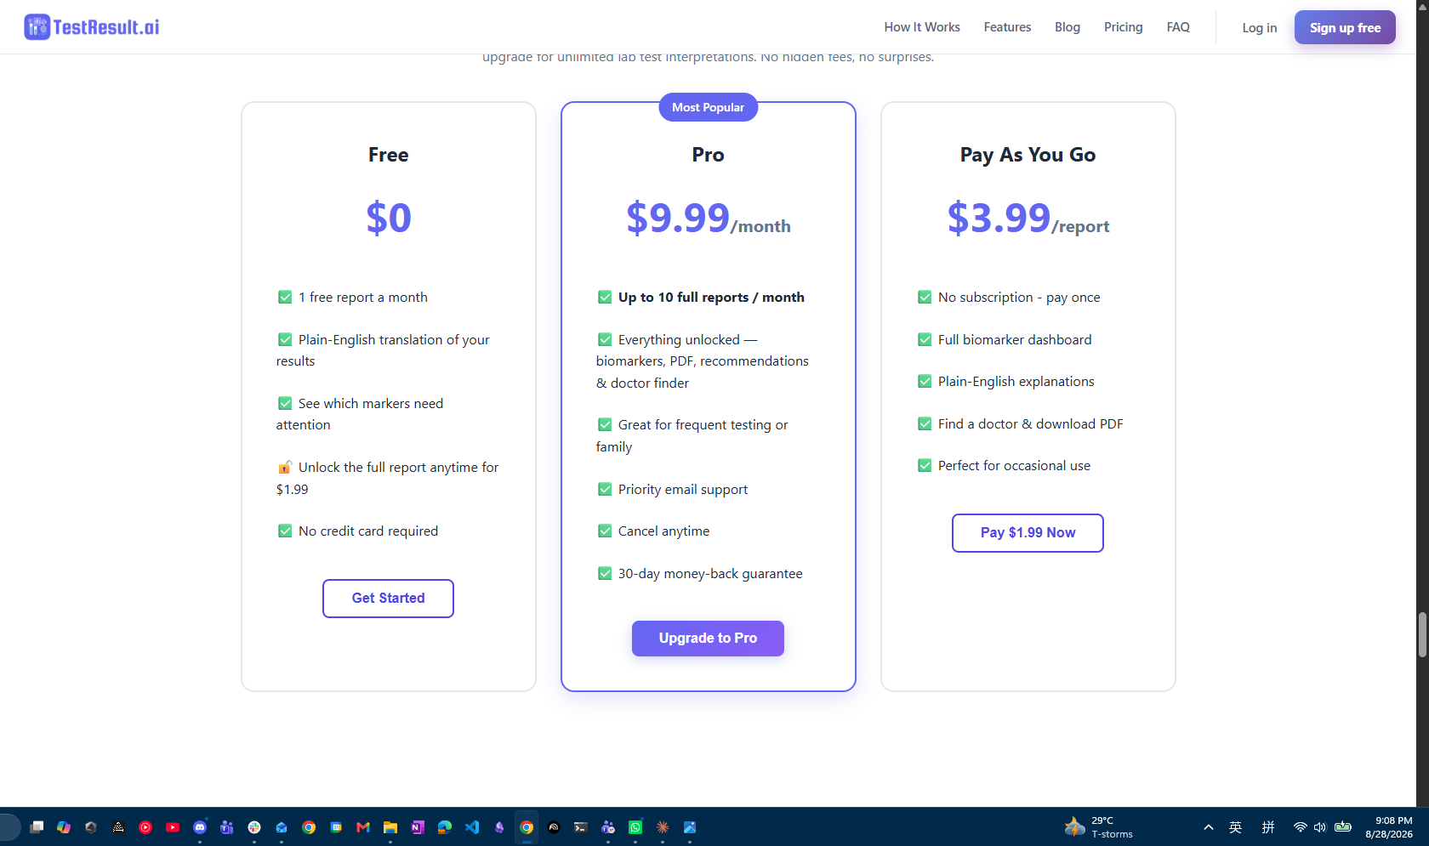
Web review – Has other ppl done similar things

Slide 7
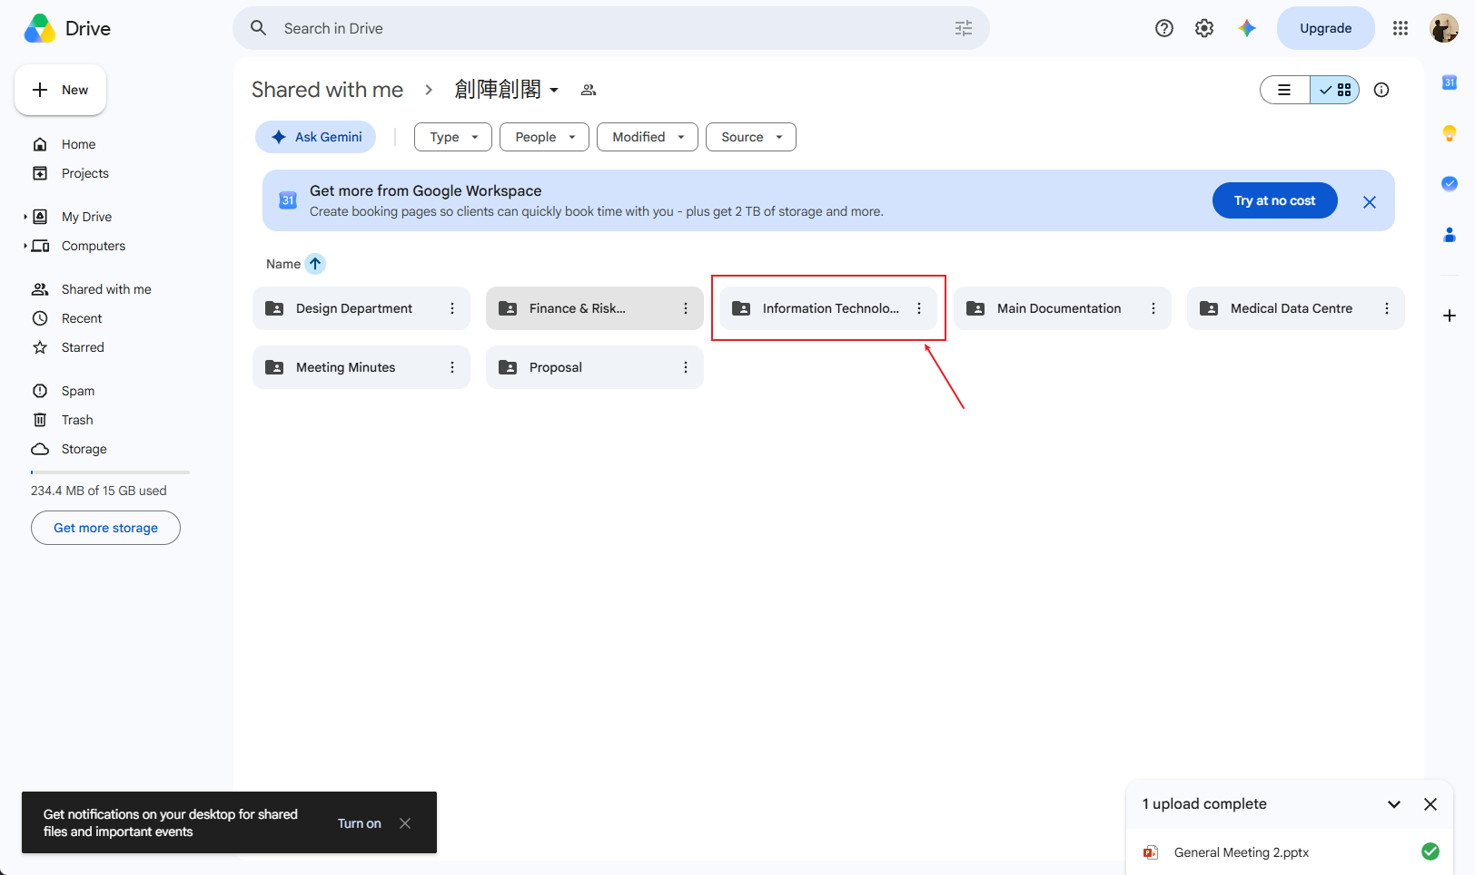


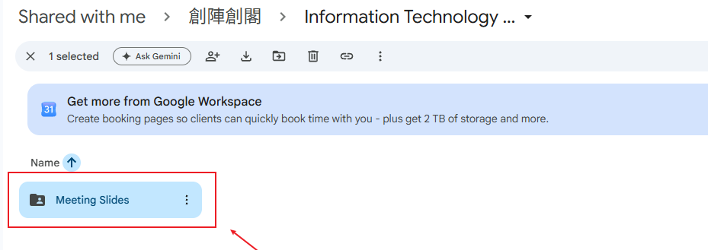
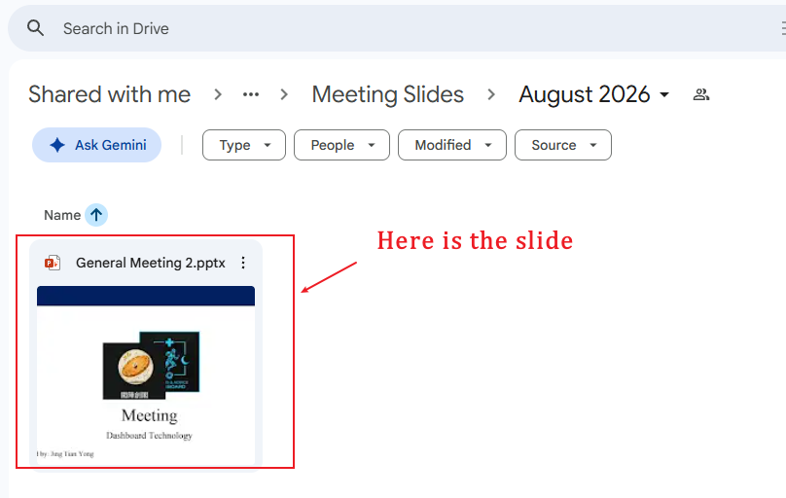
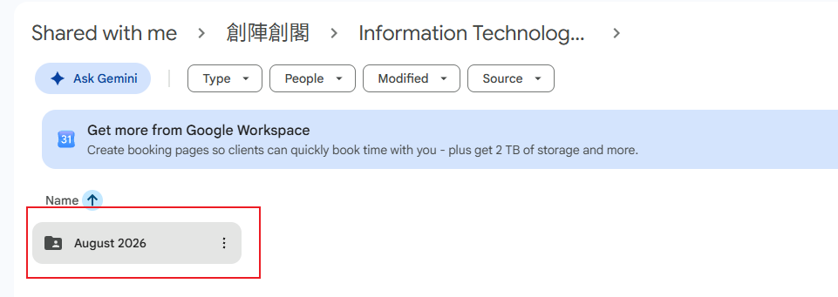
And more

Slide 8
Thanks
QnA/discussion

Slide 9
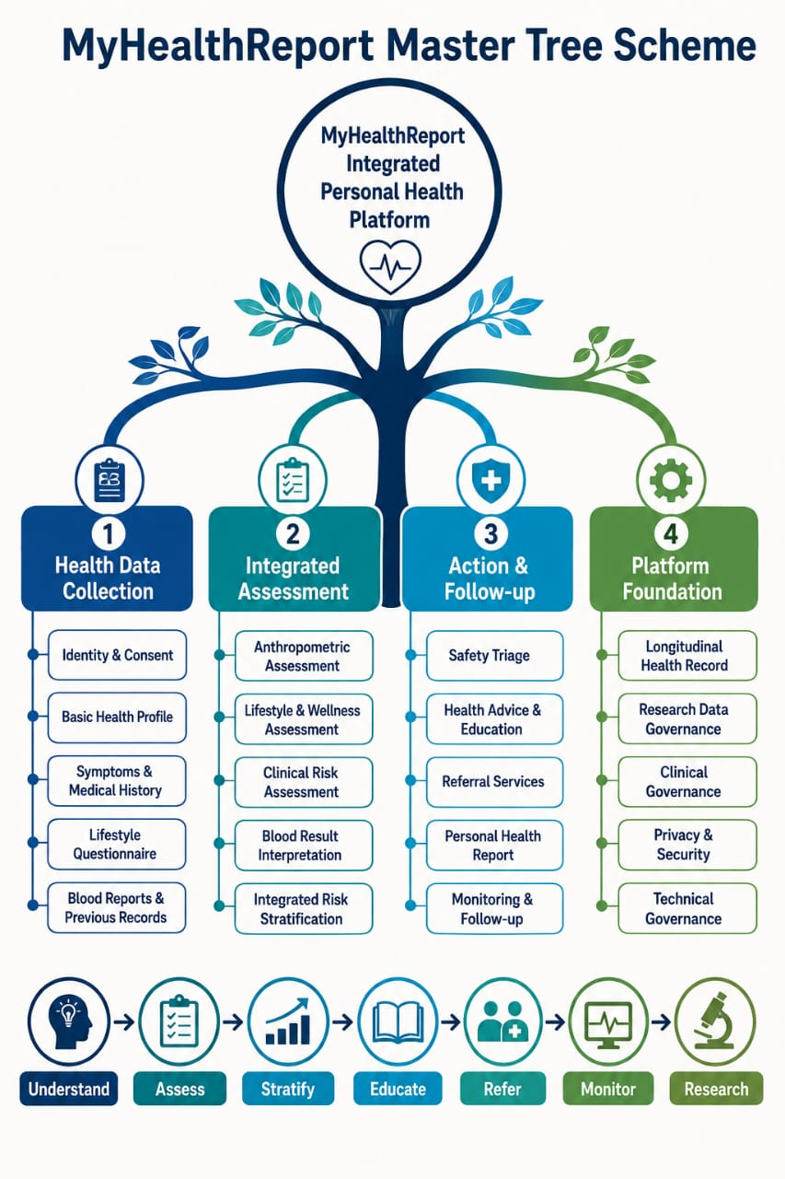
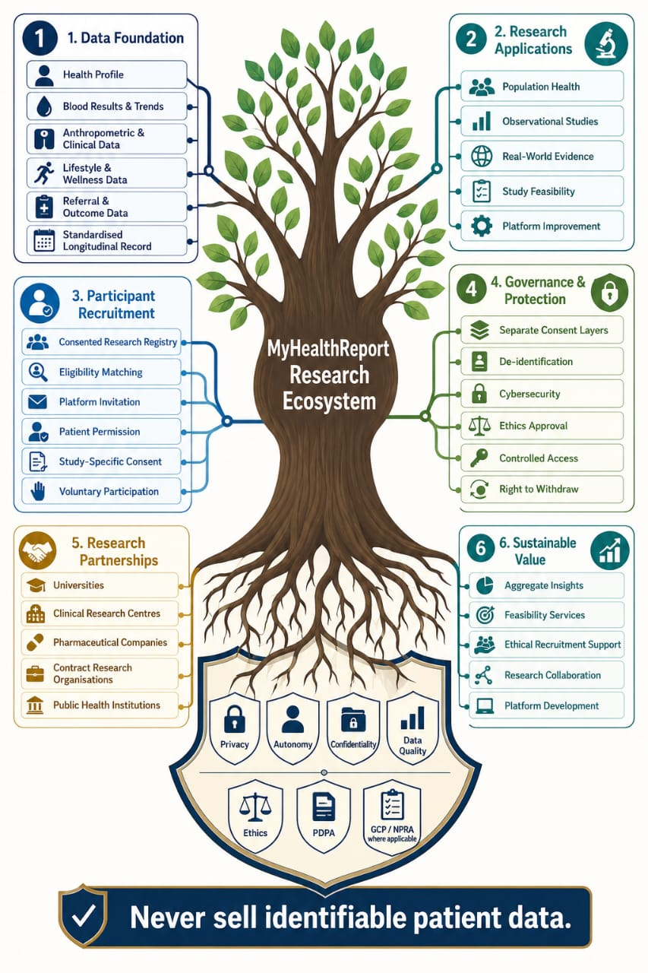
Information from the team

Slide 10
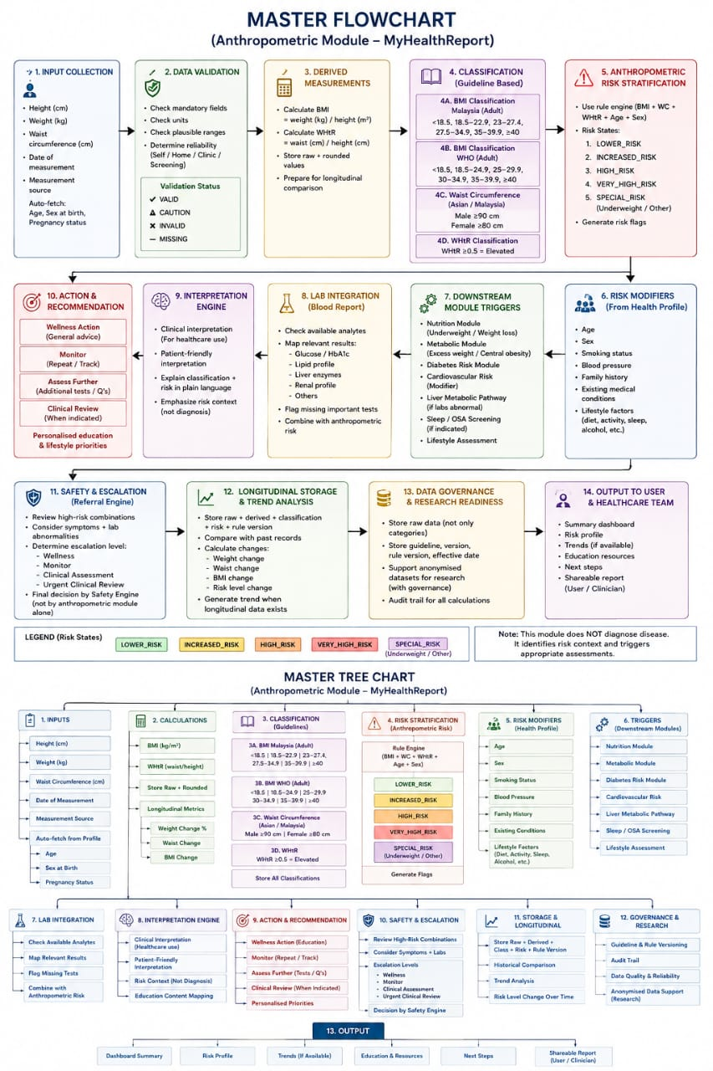
Information from the team
* By Dexter, Thanks.

Slide 11
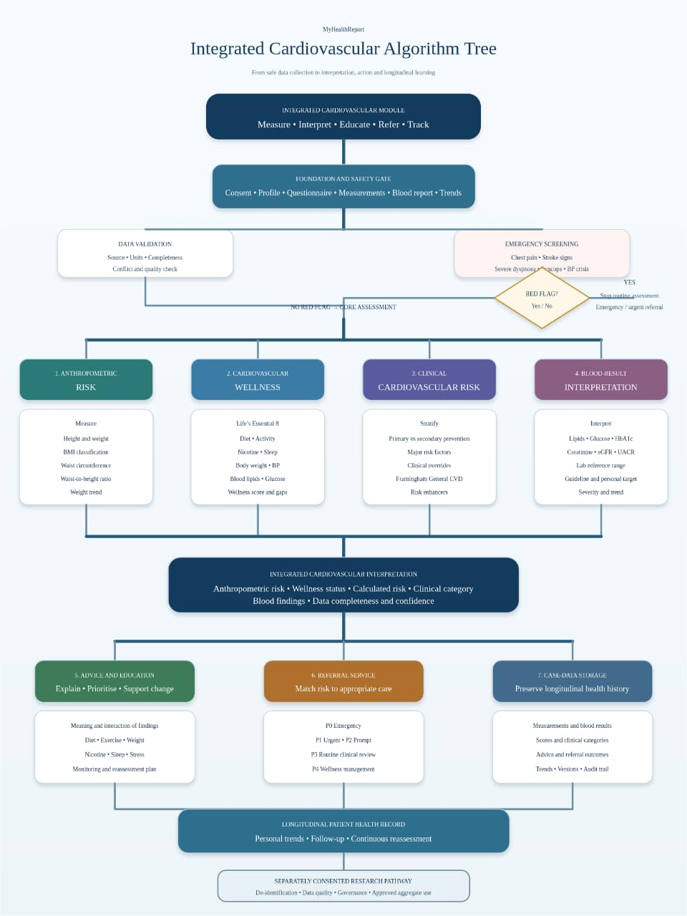
Information from the team
* By Dexter, Thanks.

Slide 12
Information from the team
* By Dexter, Thanks.

